Slide 1

Head and Spine Injuries
CHAPTER 29

Slide 2
National EMS Education Standard Competencies (1 of 4)
Trauma
Applies fundamental knowledge to provide basic emergency care and transportation based on assessment findings for an acutely injured patient.
Notes:
National EMS Education Standard Competencies
Trauma
Applies fundamental knowledge to provide basic emergency care and transportation based on assessment findings for an acutely injured patient.

Slide 3
National EMS Education Standard Competencies (2 of 4)
Head, Facial, Neck, and Spine Trauma
Recognition and management of
  Life threats
  Spine trauma
Notes:
National EMS Education Standard Competencies
Head, Facial, Neck, and Spine Trauma
Recognition and management of
• Life threats
• Spine trauma

Slide 4
National EMS Education Standard Competencies (3 of 4)
Head, Facial, Neck, and Spine Trauma (cont’d)
Pathophysiology, assessment, and management of
  Spine trauma
  Skull fractures
Notes:
National EMS Education Standard Competencies
Pathophysiology, assessment, and management of
• Spine trauma
• Skull fractures

Slide 5
National EMS Education Standard Competencies (4 of 4)
Nervous System Trauma
Pathophysiology, assessment, and management of
  Traumatic brain injury
  Spinal cord injury
Notes:
National EMS Education Standard Competencies
Nervous System Trauma
Pathophysiology, assessment, and management of
• Traumatic brain injury
• Spinal cord injury

Slide 6
Introduction (1 of 2)
The nervous system is a complex network of nerve cells that enables all parts of the body to function.
Includes:
  Brain
  Spinal cord
  Nerves and nerve fibers
Notes:
Lecture Outline
I. Introduction
A. The nervous system is a complex network of nerve cells that enables all parts of the body to function.
B. The nervous system includes:
1. Brain
2. Spinal cord
3. Nerves and nerve fibers

Slide 7
Introduction (2 of 2)
The nervous system is well protected.
  The brain is protected by the skull.
  The spinal cord is protected by the spinal canal.
Despite this protection, serious injuries can damage the nervous system.
Notes:
Lecture Outline
C. The nervous system is well protected.
1. The brain is protected by the skull.
2. The spinal cord is protected by the bony spinal canal.
3. Despite this protection, serious injuries can damage the nervous system.

Slide 8
Anatomy and Physiology (1 of 2)
The nervous system is divided into two anatomic parts.
  Central nervous system
  Peripheral nervous system
Notes:
Lecture Outline
II. Anatomy and Physiology
A. The nervous system is divided into two anatomic parts.
1. Central nervous system
2. Peripheral nervous system

Slide 9
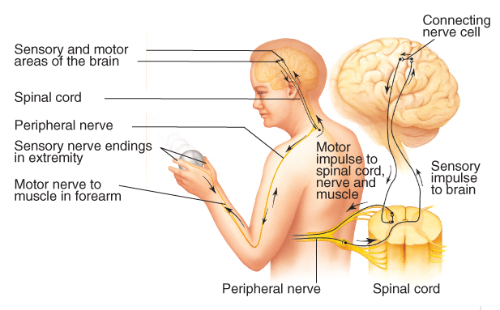
Anatomy and Physiology (2 of 2)
FIGURE 29-1 The nervous system has two anatomic components: the central nervous system and the peripheral nervous system. The central nervous system is composed of the brain and the spinal cord. The peripheral nervous system conducts sensory and motor impulses from the skin and other organs to the spinal cord.
© Jones & Bartlett Learning.
Notes:
This figure shows the two components of the nervous system: the central nervous system and the peripheral nervous system.

Slide 10
Central Nervous System (1 of 9)
Includes the brain and spinal cord
The brain controls the body and is the center of consciousness.
Brain is divided into three major areas:
  Cerebrum
  Cerebellum
  Brainstem
Notes:
Lecture Outline
B. Central nervous system (CNS)
1. Includes the brain and spinal cord
2. The brain controls the body and is the center of consciousness.
3. The brain is divided into three major areas:
a. Cerebrum
b. Cerebellum
c. Brainstem

Slide 11
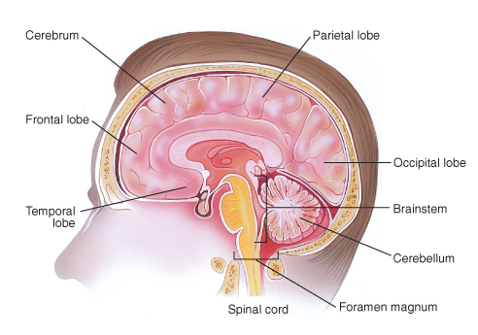
Central Nervous System (2 of 9)
FIGURE 29-2 The brain is part of the central nervous system and is the organ that controls the body. It is divided into three major areas: the cerebrum, the cerebellum, and the brainstem.
© Jones & Bartlett Learning.
Notes:
This figure shows the parts of the brain.

Slide 12
Central Nervous System (3 of 9)
Cerebrum
  Controls a wide variety of activities, including most voluntary motor function and conscious thought
  Contains about 75% of the brain’s total volume
  Divided into two hemispheres with four lobes
Notes:
Lecture Outline
4. The cerebrum controls a wide variety of activities, including most voluntary motor function and conscious thought.
a. Contains about 75% of the brain’s total volume
b. Divided into two hemispheres with four lobes

Slide 13
Central Nervous System (4 of 9)
Cerebellum
  Coordinates balance and body movements
Brainstem
  Controls most functions necessary for life
  Best-protected part of the CNS
Notes:
Lecture Outline
5. The cerebellum coordinates balance and body movements.
6. The brainstem controls most functions necessary for life, including the cardiac and respiratory systems and nerve function transmissions.
a. Best-protected part of the CNS

Slide 14
Central Nervous System (5 of 9)
Spinal cord
  Made up of fibers that extend from the brain’s nerve cells
  Carries messages between the brain and the body via the grey and white matter of the spinal cord
Notes:
Lecture Outline
7. The spinal cord is mostly made up of fibers that extend from the brain’s nerve cells.
a. Carries messages between the brain and the body via the gray and white matter of the spinal cord

Slide 15
Central Nervous System (6 of 9)
Protective coverings
  The entire CNS is contained within a protective framework.
  The thick, bony structures of the skull and spinal canal withstand injury very well.
  The CNS is further protected by the meninges.
Notes:
Lecture Outline
8. Protective coverings
a. The brain and spinal cord are covered with thick, bony structures.
b. The CNS is further protected by the meninges, three distinct layers of tissue that suspend the brain and the spinal cord within the skull and the spinal canal.

Slide 16
Central Nervous System (7 of 9)
Meninges
  Outer layer (dura mater) is a tough, fibrous layer that forms a sac to contain the CNS.
  Inner two layers (arachnoid mater and pia mater) contain the blood vessels.
Notes:
Lecture Outline
b. The CNS is further protected by the meninges, three distinct layers of tissue that suspend the brain and the spinal cord within the skull and the spinal canal.
i. The outer layer, the dura mater, is a tough, fibrous layer that forms a sac to contain the CNS.
ii. The inner two layers, called the arachnoid mater and the pia mater, contain the blood vessels that nourish the brain and spinal cord.

Slide 17
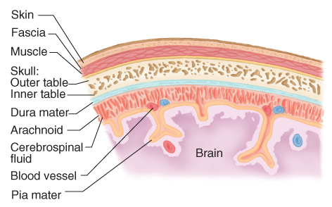
Central Nervous System (8 of 9)
FIGURE 29-3 The central nervous system has several layers of protective coverings: the skin, muscles and their fascia, bone, and the meninges. The three layers of the meninges are the dura mater, the arachnoid, and the pia mater.
© Jones & Bartlett Learning.
Notes:
This figure shows the layers of protective coverings surrounding the brain.

Slide 18
Central Nervous System (9 of 9)
Cerebrospinal fluid (CSF)
  Produced in a chamber inside the brain called the third ventricle
  Approximately 125 to 150 mL of CSF in the brain at any time
  Primarily acts as a shock absorber
Notes:
Lecture Outline
c. Cerebrospinal fluid (CSF) is produced in a chamber inside the brain, called the third ventricle.
i. CSF primarily acts as a shock absorber.
ii. When an injury does penetrate all the protective layers, clear, watery CSF may leak from the nose, the ears, or an open skull fracture.

Slide 19
Peripheral Nervous System (1 of 5)
31 pairs of spinal nerves
  Conduct impulses from the skin and other organs to the spinal cord
  Conduct motor impulses from the spinal cord to the muscles
Notes:
Lecture Outline
C. Peripheral nervous system
1. 31 pairs of spinal nerves
a. Conduct impulses from the skin and other organs to the spinal cord
b. Conduct motor impulses from the spinal cord to the muscles

Slide 20
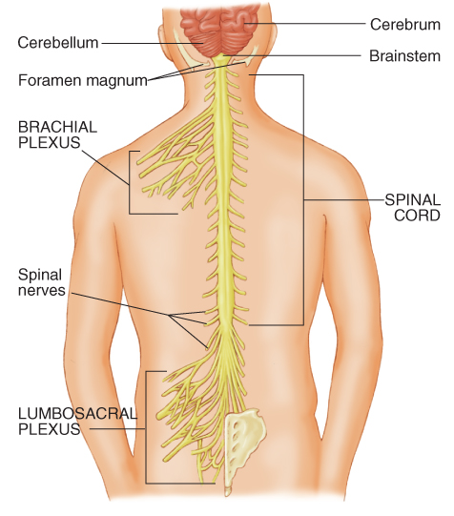
Peripheral Nervous System (2 of 5)
FIGURE 29-4 The peripheral nervous system is a complex network of motor and sensory nerves. The brachial plexus controls the arms, and the lumbosacral plexus controls the legs.
© Jones & Bartlett Learning.
Notes:
This figure shows the major nerves of the peripheral nervous system.

Slide 21
Peripheral Nervous System (3 of 5)
12 pairs of cranial nerves
  Transmit information directly to or from the brain
  Perform special functions in the head and face, including sight, smell, taste, hearing, and facial expressions
Notes:
Lecture Outline
2. 12 pairs of cranial nerves
a. Transmit information directly to or from the brain
b. Perform special functions in the head and face, including sight, smell, taste, hearing, and facial expressions

Slide 22
Peripheral Nervous System (4 of 5)
Two types of peripheral nerves
  Sensory nerves
    Carry only one type of information from the body to the brain via the spinal cord
  Motor nerves
    One for each muscle
    Carry information from the CNS to the muscles
Notes:
Lecture Outline
3. There are two major types of peripheral nerves.
a. Sensory nerves
i. Carry only one type of information from the body to the brain via the spinal cord
b. Motor nerves
i. Carry information from the CNS to the muscles

Slide 23
Peripheral Nervous System (5 of 5)
Connecting nerves
  Found only in the brain and spinal cord
  Connect the sensory and motor nerves with short fibers
  Allow the exchange of simple messages
Notes:
Lecture Outline
4. The connecting nerves are found only in the brain and spinal cord.
a. Connect the sensory and motor nerves with short fibers
b. Allow the exchange of simple messages

Slide 24
How the Nervous System Works (1 of 5)
Controls virtually all the body’s activities, including:
  Reflex activities
  Voluntary activities
  Involuntary activities
Notes:
Lecture Outline
D. How the nervous system works
1. The nervous system controls virtually all of the body’s activities, including:
a. Reflex activities
b. Voluntary activities
c. Involuntary activities

Slide 25
How the Nervous System Works (2 of 5)
Connecting nerves in the spinal cord form a reflex arc.
  If a sensory nerve in this arc detects an irritating stimulus, it bypasses the brain and sends the message directly to a motor nerve.
Notes:
Lecture Outline
2. The connecting nerves in the spinal cord form a reflex arc.
a. If a sensory nerve in this arc detects an irritating stimulus, it bypasses the brain and sends the message directly to a motor nerve, causing a response.

Slide 26
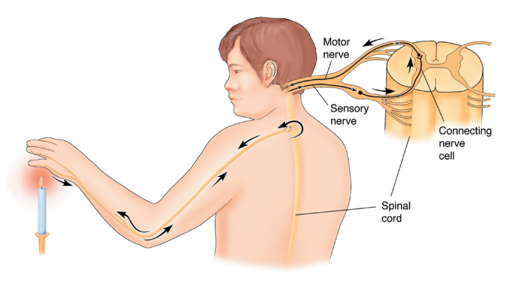
How the Nervous System Works (3 of 5)
FIGURE 29-5 The connecting nerves in the spinal cord form a reflex arc. If a sensory nerve in this arc detects an irritating stimulus, it will bypass the brain and send a direct message to a motor nerve.
© Jones & Bartlett Learning.
Notes:
This figure shows the reflex arc.

Slide 27
How the Nervous System Works (4 of 5)
Voluntary activities are activities we consciously perform.
Involuntary activities are the actions that are not under conscious control.
Somatic (voluntary) nervous system handles voluntary activities.
Notes:
Lecture Outline
3. The somatic (voluntary) nervous system handles voluntary activities.

Slide 28
How the Nervous System Works (5 of 5)
Autonomic (involuntary) nervous system handles body functions.
  Divided into two sections: sympathetic and parasympathetic nervous systems
  Sympathetic nervous system reacts to stress with a fight-or-flight response.
  Parasympathetic nervous system has the opposite effect on the body.
Notes:
Lecture Outline
4. The autonomic (involuntary) nervous system handles the body functions that occur without conscious effort.
a. Divided into two sections: sympathetic and parasympathetic nervous systems
i. When confronted with a threatening situation, the sympathetic nervous system reacts to the stress with a fight-or-flight response.
ii. The parasympathetic nervous system has the opposite effect on the body, causing blood vessels to dilate, slowing the heart rate, and relaxing the muscle sphincters.
b. The two divisions of the autonomic nervous system tend to balance each other so that basic body functions remain stable and effective (homeostasis).

Slide 29
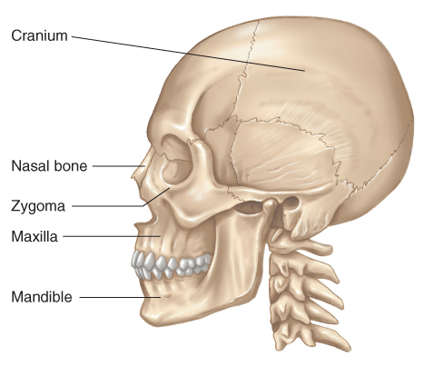
Skeletal System (1 of 5)
Skull
  Composed of two groups of bones: cranium and facial bones.
FIGURE 29-6 The skull includes two large structures: the cranium and the face.
© Jones & Bartlett Learning.
Notes:
Lecture Outline
E. Skeletal system
1. Skull
a. Composed of two groups of bones: the cranium and the facial bones.

Slide 30
Skeletal System (2 of 5)
Skull (cont’d)
  The brain connects to the spinal cord through the foramen magnum.
  Four major bones make up the cranium: occipital, temporal, parietal, and frontal.
  Face is composed of 14 bones: maxillae, zygomas, mandible, and orbit.
Notes:
Lecture Outline
b. The brain connects to the spinal cord through a large opening at the base of the skull called the foramen magnum.
c. Four major bones make up the cranium:
i. Occipital, temporal, parietal and frontal
d. The face is composed of 14 bones.
i. Maxilla, zygoma, mandible, nasal, and frontal bones

Slide 31
Skeletal System (3 of 5)
Spinal column
  Body’s central supporting structure
  33 vertebrae are divided into five sections:
    Cervical
    Thoracic
    Lumbar
    Sacral
    Coccygeal
Notes:
Lecture Outline
2. Spinal column
a. The body’s central supporting structure.
b. 33 vertebrae are divided into five sections: cervical, thoracic, lumbar, sacral, and coccygeal.

Slide 32
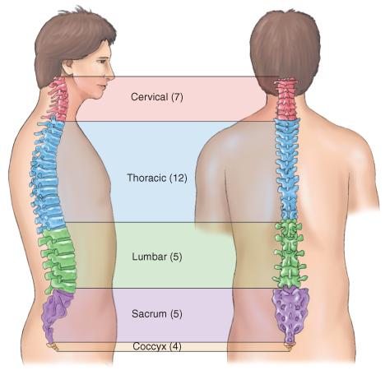
Skeletal System (4 of 5)
FIGURE 29-7 The spinal column is the body’s central
supporting system and consists of 33 bones divided into
five sections. Injury to the vertebrae may cause paralysis.
© Jones & Bartlett Learning.
Notes:
This figure shows the five sections of the spinal column.

Slide 33
Skeletal System (5 of 5)
Spinal column (cont’d)
  Injury to the vertebrae can result in paralysis.
  Vertebrae are connected by ligaments and separated by cushions, called intervertebral disks.
  Spinal column is almost entirely surrounded by muscles.
Notes:
Lecture Outline
c. The front part of each vertebra consists of a round, solid block of bone called the vertebral body; the back part forms a bony arch.
d. The series of arches form a tunnel called the spinal canal, which encases and protects the spinal cord.
The vertebrae are connected by ligaments and separated by cushions, called intervertebral disks.

Slide 34
Head Injuries (1 of 4)
Traumatic insult to the head that may result in injury to soft tissue, bony structures, or the brain.
Account for more than half of all traumatic deaths
The patient may have sustained additional trauma.
Notes:
Lecture Outline
III. Head Injuries
A. A head injury is a traumatic insult to the head that may result in injury to soft tissue, bony structures, or the brain.
1. Head injuries account for more than half of all traumatic deaths.
2. Fatal injuries invariably involve the brain.
3. Be alert to the fact that the patient may have sustained additional trauma.

Slide 35
Head Injuries (2 of 4)
Closed injuries
  The brain has been injured but there is no opening into the brain.
Open injuries
  An opening from the brain to the outside world exists.
  Often caused by penetrating trauma
  May be bleeding and exposed brain tissue
Notes:
Lecture Outline
B. There are two general types of head injuries: closed head injuries and open head injuries.
1. Closed head injuries are those in which the brain has been injured but there is no opening into the brain.
2. An open head injury is one in which an opening from the brain to the outside world exists.
a. Often caused by penetrating trauma.
b. Brain tissue may be exposed

Slide 36
Head Injuries (3 of 4)
Falls and motor vehicle crashes are among the most common MOI.
  Head injuries also commonly occur:
    In victims of assault
    During sports-related incidents
Notes:
Lecture Outline
C. Falls and motor vehicle crashes are the most common MOI.
1. Other common MOIs include assaults and sports-related incidents.

Slide 37
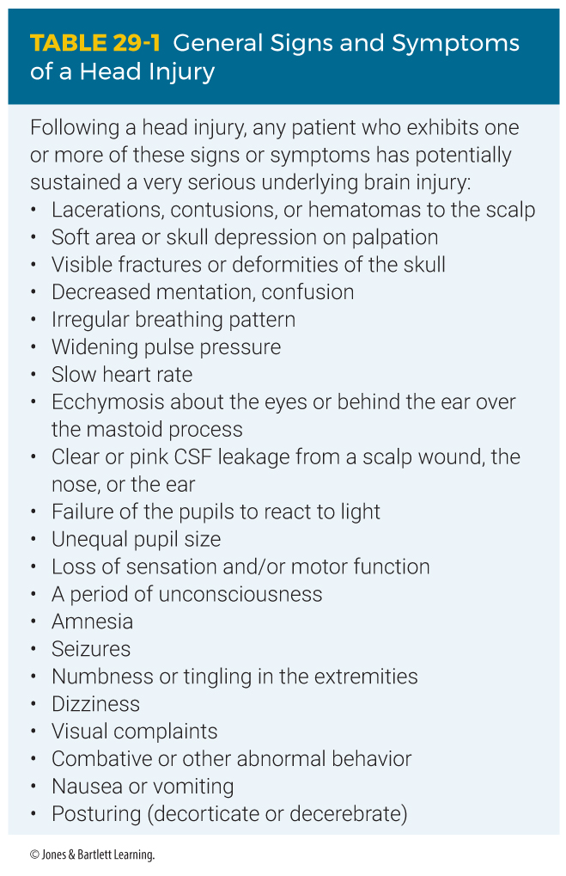
Head Injuries (4 of 4)
Notes:
The table on this slide shows the general signs and symptoms of a head injury.

Slide 38
Scalp Lacerations
Can be minor or serious
Even small lacerations can lead to significant blood loss.
  May be severe enough to cause hypovolemic shock
They are often an indicator of deeper, more serious injuries.
Notes:
Lecture Outline
D. Scalp lacerations
1. Can be minor or serious
2. Even small lacerations can quickly lead to significant blood loss, especially in children.
3. In patients with multiple injuries, bleeding from scalp or facial lacerations may contribute to hypovolemia.

Slide 39
Skull Fracture (1 of 7)
Significant force applied to the head may cause a skull fracture.
May be open or closed, depending on whether there is an overlying laceration of the scalp
Injuries from bullets or other penetrating weapons often result in skull fractures.
Notes:
Lecture Outline
E. Skull fracture
1. Significant force applied to the head may cause a skull fracture.
2. May be open or closed, depending on whether there is an overlying laceration of the scalp.
3. Injuries from bullets or other penetrating weapons frequently result in fracture of the skull.

Slide 40
Skull Fracture (2 of 7)
Signs of skull fracture include:
  Patient’s head appears deformed.
  Visible cracks in the skull
  Ecchymosis (bruising) that develops under the eyes (raccoon eyes)
  Ecchymosis that develops behind one ear over the mastoid process (Battle sign)
Notes:
Lecture Outline
4. Signs of skull fracture include:
a. Patient’s head appears deformed
b. Visible cracks in the skull
c. Ecchymosis (bruising) that develops under the eyes (raccoon eyes)
d. Ecchymosis that develops behind one ear over the mastoid process (Battle sign)

Slide 41
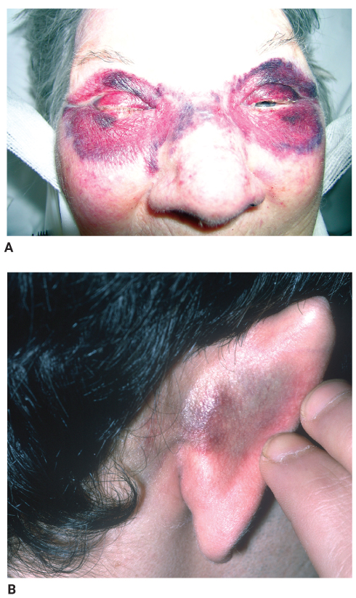
Skull Fracture (3 of 7)
FIGURE 29-10 Signs of skull fracture include ecchymosis under the eyes (raccoon eyes) (A) or behind one ear over the mastoid process (Battle sign) (B).
A: © E. M. Singletary, MD. Used with permission; B: © Mediscan/Alamy.
Notes:
These figures show ecchymosis under the eyes (A) and behind one ear (B), signs of a skull fracture.

Slide 42
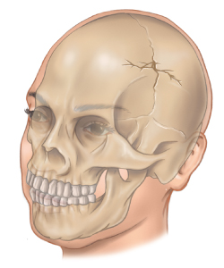
Skull Fracture (4 of 7)
Linear skull fractures
  Account for about 80% of all skull fractures
  Radiographs are required to diagnose a linear skull fracture because there are no physical signs.
FIGURE 29-11A Types of skull fractures. Linear.
© Jones & Bartlett Learning.
Notes:
Lecture Outline
5. Linear skull fractures
a. Account for approximately 80% of all fractures to the skull
b. Radiographs are required to diagnose a linear skull fracture because there are often no physical signs such as deformity.

Slide 43
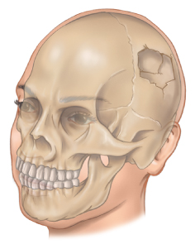
Skull Fracture (5 of 7)
Depressed skull fractures
  Result from high-energy direct trauma to the head with a blunt object
  Frontal and parietal bones are most susceptible.
  Bony fragments may be driven into the brain.
FIGURE 29-11B Types of skull fractures. Depressed.
© Jones & Bartlett Learning.
Notes:
Lecture Outline
6. Depressed skull fractures
a. Result from high-energy direct trauma to the head with a blunt object
b. The frontal and parietal bones of the skull are most susceptible.
c. Bony fragments may be driven into the brain, resulting in injury.
d. Patients often present with signs of neurologic injury (such as loss of consciousness).

Slide 44
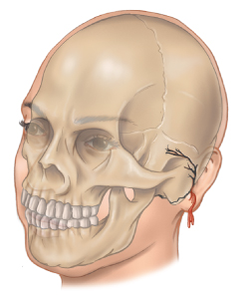
Skull Fracture (6 of 7)
Basilar skull fractures
  Associated with high-energy trauma
  Usually occur following diffuse impact to the head
  Signs include CSF drainage from the ears, raccoon eyes, and Battle sign.
FIGURE 29-11C Types of skull fractures. Basilar.
© Jones & Bartlett Learning.
Notes:
Lecture Outline
7. Basilar skull fractures
a. Associated with high-energy trauma, but usually occur following diffuse impact to the head
b. These injuries generally result from extension of a linear fracture to the base of the skull and are usually diagnosed with a CT of the head.
c. Signs of a basilar skull fracture include CSF drainage from the ears, raccoon eyes, and Battle sign.

Slide 45
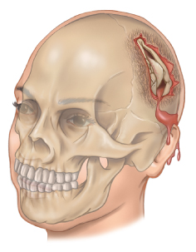
Skull Fracture (7 of 7)
Open skull fractures
  Often associated with trauma to multiple body systems
  Brain tissue may be exposed to the environment.
  High mortality rate
FIGURE 29-11D Types of skull fractures. Open.
© Jones & Bartlett Learning.
Notes:
Lecture Outline
8. Open skull fractures
a. Often associated with trauma to multiple body systems
b. Brain tissue may be exposed to the environment, which significantly increases the risk of a bacterial infection.
c. Have a very high mortality rate

Slide 46
Traumatic Brain Injuries (1 of 4)
Most serious of all head injuries
Two broad categories: primary (direct) injury and secondary (indirect) injury
  Primary brain injury results instantaneously from impact to the head.
  Secondary brain injury increases the severity of the primary injury.
Notes:
Lecture Outline
F. Traumatic brain injuries (TBI)
1. Defined by the National Head Injury Foundation as “a traumatic insult to the brain capable of producing physical, intellectual, emotional, social, and vocational changes.”
2. Classified into two broad categories: primary (direct) injury and secondary (indirect) injury
a. Primary brain injury results instantaneously from impact to the head.
b. Secondary brain injury increases the severity of the primary injury.

Slide 47
Traumatic Brain Injuries (2 of 4)
Secondary injury may be caused by:
  Hypoxia
  Hypotension
  Cerebral edema
  Intracranial hemorrhage
  Increased intracranial pressure
  Cerebral ischemia
  Infection
Notes:
Lecture Outline
b. Secondary brain injury increases the severity of the primary injury, and may be caused by:
i. Cerebral edema
ii. Intracranial hemorrhage
iii. Increased intracranial pressure
iv. Cerebral ischemia
v. Infection
c. Hypoxia and hypotension are the two most common causes of secondary brain injury and will increase death and disability significantly in a patient with head injury.
d. Secondary injuries may occur anywhere from a few minutes to several days following the initial head injury.

Slide 48
Traumatic Brain Injuries (3 of 4)
The brain can be injured directly by a penetrating object or indirectly as a result of external forces.
A coup-contrecoup injury can result from striking a windshield.
  Head hits the windshield; brain comes to an abrupt stop by striking the inside of the skull.
  Head falls back against headrest; brain slams into the rear of the skull.
Notes:
Lecture Outline
3. Can result from blunt or penetrating trauma
4. Coup-contrecoup injury
a. The initial impact injures the front part of the brain.
b. The head falling back against the headrest then injures the rear part of the brain.
5. Cerebral edema may not develop until several hours following the initial injury.
6. Low blood oxygen levels aggravate cerebral edema.
7. Monitor the patient for any seizure activity.

Slide 49
Traumatic Brain Injuries (4 of 4)
Cerebral edema may not develop for several hours.
Low blood oxygen levels aggravate cerebral edema.
Monitor the patient for any seizure activity.
Notes:
Lecture Outline
5. Cerebral edema may not develop until several hours following the initial injury.
6. Low blood oxygen levels aggravate cerebral edema.
7. Monitor the patient for any seizure activity.

Slide 50
Intracranial Pressure (1 of 7)
Accumulations of blood within the skull or swelling of the brain can rapidly lead to an increase in ICP.
  Increased ICP squeezes the brain against bony prominences within the cranium.
Notes:
Lecture Outline
G. Intracranial pressure
1. Accumulations of blood within the skull or swelling of the brain can rapidly lead to an increase in intracranial pressure (ICP).
a. Increased ICP squeezes the brain against bony prominences within the cranium.

Slide 51
Intracranial Pressure (2 of 7)
Signs of increased intracranial pressure
  Cheyne-Stokes respirations
  Ataxic (Biot) respirations
  Decreased pulse rate, headache, nausea, vomiting, decreased alertness, bradycardia, sluggish or nonreactive pupils, decerebrate posturing, and increased or widened blood pressure.
  Cushing reflex
Notes:
Lecture Outline
2. Signs of increased intracranial pressure:
a. Abnormal respiratory patterns such as ataxic (Biot) and Cheyne-Stokes
b. Decreased pulse rate, headache, nausea, vomiting, decreased alertness, bradycardia, sluggish or nonreactive pupils, decerebrate posturing, and increased or widened blood pressure
c. Cushing reflex: the symptom triad of increased systolic blood pressure, decreased pulse rate, and irregular respirations.

Slide 52
Intracranial Pressure (3 of 7)
Intracranial hemorrhage
  Bleeding inside the skull also increases the ICP.
  Bleeding can occur:
    Between the skull and dura mater
    Beneath the dura mater but outside the brain
    Within the tissue of the brain itself
Notes:
Lecture Outline
3. Intracranial hemorrhage
a. Bleeding inside the skull also increases the ICP.
b. Bleeding can occur between the skull and dura mater, beneath the dura mater but outside the brain, or within the tissue of the brain itself.

Slide 53
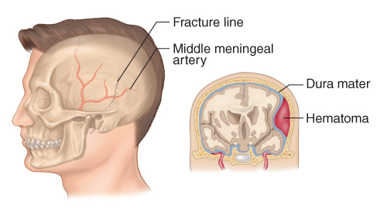
Intracranial Pressure (4 of 7)
Epidural hematoma
  Accumulation of blood between the skull and dura mater
  Nearly always the result of a blow to the head that produces a linear fracture
FIGURE 29-13 An epidural hematoma is usually the result of a blow to the head that produces a linear fracture of the temporal bone and damages the middle meningeal artery. Blood accumulates between the dura mater and the skull.
© Jones & Bartlett Learning.
Notes:
Lecture Outline
5. Epidural hematoma
a. Accumulation of blood between the skull and dura mater
b. Nearly always the result of a blow to the head that produces a linear fracture of the thin temporal bone
i. The middle meningeal artery run along a grove in the temporal bone
c. Arterial bleeding into the epidural space will result in rapidly progressing symptoms.
d. Often, the patient loses consciousness immediately following the injury.
e. This is often followed by a brief period of consciousness (lucid interval), after which the patient lapses back into unconsciousness.
i. The pupil on the side of the hematoma becomes fixed and dilated.
ii. Death will follow very rapidly without surgery to evacuate the hematoma.

Slide 54
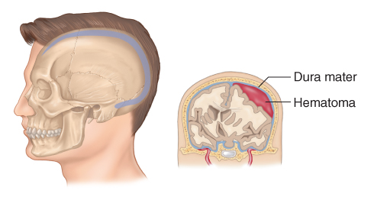
Intracranial Pressure (5 of 7)
Subdural hematoma
  Accumulation of blood beneath the dura mater but outside the brain
  Occurs after falls or injuries involving strong deceleration forces
  May or may not be skull fracture
FIGURE 29-14 In a subdural hematoma, venous bleeding occurs beneath the dura mater but outside the brain.
© Jones & Bartlett Learning.
Notes:
Lecture Outline
5. Subdural hematoma
a. Accumulation of blood beneath the dura mater but outside the brain
b. Usually occurs after falls or injuries involving strong deceleration forces
c. More common than epidural hematomas and may or may not be associated with a skull fracture
d. Associated with venous bleeding, so the signs typically develop more gradually than with an epidural hematoma.
e. The patient often experiences a fluctuating level of consciousness or slurred speech.
f. Any patient with a suspected subdural hematoma needs to be evaluated by a physician.

Slide 55
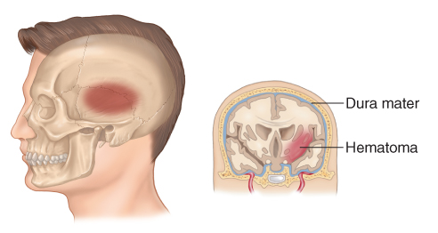
Intracranial Pressure (6 of 7)
Intracerebral hematoma
  Bleeding within the brain tissue itself
  Can occur following a penetrating injury to the head or because of rapid deceleration forces
FIGURE 29-15 An intracerebral hematoma involves
bleeding within the brain tissue itself.
© Jones & Bartlett Learning.
Notes:
Lecture Outline
6. Intracerebral hematoma
a. Involves bleeding within the brain tissue itself
b. Can occur following a penetrating injury to the head or because of rapid deceleration forces
c. Many small, deep intracerebral hemorrhages are associated with other brain injuries.
d. The progression of increased ICP depends on the presence of other brain injuries, the region of the brain involved, and the size of the hemorrhage.
e. Intracerebral hematomas have a high mortality rate, even if the hematoma is surgically evacuated.

Slide 56
Intracranial Pressure (7 of 7)
Subarachnoid hemorrhage
  Bleeding occurs into the subarachnoid space, where the CSF circulates.
  Results in bloody CSF and signs of meningeal irritation
  Common causes include trauma or rupture of an aneurysm.
Notes:
Lecture Outline
7. Subarachnoid hemorrhage
a. Bleeding occurs into the subarachnoid space, where the CSF circulates.
b. Results in bloody CSF and signs of meningeal irritation (neck rigidity, headache)
c. Common causes include trauma or rupture of an aneurysm.
d. Patient reports a sudden, severe headache.
e. As bleeding increases, the patient will experience signs and symptoms of increased ICP.
f. A sudden, severe subarachnoid hematoma usually results in death; survivors often have permanent neurologic impairment.

Slide 57
Concussion (1 of 3)
A blow to the head or face may cause concussion of the brain.
  Closed injury with a temporary loss or alteration of part or all of the brain’s abilities to function without demonstrable physical damage to the brain
  About 90% of patients do not experience a loss of consciousness.
Notes:
Lecture Outline
H. Concussion
1. A blow to the head or face may cause concussion of the brain.
2. Classified as mild TBIs.
3. It is a closed injury with a temporary loss or alteration of part or all of the brain’s abilities to function without demonstrable physical damage to the brain.
4. Approximately 90% of patients who sustain a concussion do not experience a loss of consciousness.

Slide 58
Concussion (2 of 3)
A patient with a concussion may be confused or have amnesia.
Usually a concussion lasts only a short time.
Notes:
Lecture Outline
5. A patient with a concussion may be confused or have amnesia.
a. Retrograde amnesia: the ability to remember everything but the events leading up to the injury.
b. Anterograde amnesia: The inability to remember events after the injury.

Slide 59
Concussion (3 of 3)
Ask about these symptoms:
  Dizziness
  Weakness
  Visual changes
  Nausea and vomiting
  Ringing in the ears
  Slurred speech
  Inability to focus
Notes:
Lecture Outline
6. Usually a concussion lasts only a short time.
a. Ask about symptoms of concussion such as dizziness, weakness, visual changes, or changes in mood, in any patient who has sustained an injury to the head.
b. Additional signs and symptoms include nausea and vomiting, ringing in the ears, slurred speech and the inability to focus.
7. Assume that a patient with signs or symptoms of concussion has a more serious injury until proven otherwise by a CT scan at the hospital or by evaluation by a physician.

Slide 60
Contusion
Far more serious than a concussion
Involves physical injury to brain tissue
May sustain long-lasting and even permanent damage
A patient may exhibit any or all of the signs of brain injury.
Notes:
Lecture Outline
I. Contusion
1. Bruising of the brain tissue resulting from blunt trauma
2. A contusion is far more serious than a concussion.
a. Involves physical injury to the brain tissue
b. May produce long-lasting and even permanent damage
3. A patient who has sustained a brain contusion may exhibit any or all of the signs of brain injury.

Slide 61
Other Brain Injuries
Brain injuries can also arise from medical conditions, such as blood clots or hemorrhages.
Signs and symptoms of nontraumatic injuries are often the same as those of traumatic brain injuries.
Notes:
Lecture Outline
J. Other brain injuries
1. Brain injuries can also arise from medical conditions, such as blood clots or hemorrhages.
2. Problems with the blood vessels, high blood pressure, or other problems may cause spontaneous bleeding into the brain.
3. The signs and symptoms of nontraumatic injuries are often the same as those of TBIs.

Slide 62
Spine Injuries (1 of 2)
Compression injuries can result from a fall.
  Forces that compress the patient’s vertebral body can cause herniation of disks.
Motor vehicle crashes can overextend the spine.
Rotation-flexion injuries of the spine result from rapid acceleration forces.
Notes:
Lecture Outline
IV. Spine Injuries
A. The cervical, thoracic, and lumbar portions of the spine can be injured in a variety of ways.
1. Compression injuries can result from a fall, regardless of whether the patient landed on his or her feet or experienced a direct blow to the crown of the skull, coccyx, or top of the head.
2. Forces that compress the patient’s vertebral body can cause herniation of disks, subsequent compression on the spinal cord and nerve roots, and fragmentation into the spinal canal.
3. Motor vehicle crashes or other types of trauma can overextend (hyperflex) the cervical spine and damage the ligaments and joints.
4. Rotation-flexion injuries of the spine result from rapid acceleration forces.

Slide 63
Spine Injuries (2 of 2)
When the spine is pulled along its length (hyperextension), it can cause fractures.
Any one of these unnatural motions, as well as excessive lateral bending, can result in fractures or neurologic deficit.
When bones of the spine are altered from traumatic forces, they can fracture or move out of place.
Notes:
Lecture Outline
5. Any unnatural motions can result in fractures or neurologic deficit.
6. When the spine is pulled along its length (hyperextension), it can cause fractures in the spine as well as ligament and muscle injuries.
7. When bones of the spine are altered from traumatic forces, they can fracture or move out of place.
a. Permanent damage may occur.
b. Common findings include pain and tenderness on palpation.
c. If you suspect these types of injuries, take extra precautions when stabilizing the spine.

Slide 64
Patient Assessment (1 of 2)
Always suspect a possible head or spinal injury with:
  Motor vehicle collisions
  Pedestrian–motor vehicle collisions
  Falls
  Blunt trauma
  Penetrating trauma to the head, neck, back, or torso
Notes:
Lecture Outline
V. Patient Assessment
A. Always suspect a possible head or spinal injury any time you encounter one of the following MOIs:
1. Motor vehicle collisions (including motorcycles, snowmobiles, and all-terrain vehicles)
2. Pedestrian–motor vehicle collisions
3. Falls (>20 feet [adult]; >10 feet [pediatric])
4. Blunt trauma
5. Penetrating trauma to the head, neck, back, or torso

Slide 65
Patient Assessment (2 of 2)
Always suspect a possible head or spinal injury with (cont’d):
  Rapid deceleration injuries
  Hangings
  Axial loading injuries
  Diving accidents
Notes:
Lecture Outline
6. Rapid deceleration injuries
7. Hangings
8. Axial loading injuries
9. Diving accidents

Slide 66
Scene Size-up (1 of 2)
Scene safety
  Evaluate every scene for hazards to your health and the health of your team or bystanders.
  Be prepared with appropriate standard precautions.
  Call for ALS as soon as possible.
Notes:
Lecture Outline
B. Scene size-up
1. Scene safety
a. Evaluate every scene for hazards to your health and the health of your team or bystanders.
b. Be prepared with appropriate standard precautions before you approach the patient in a motor vehicle crash.
c. Call for ALS as soon as possible.

Slide 67
Scene Size-up (2 of 2)
Mechanism of injury/nature of illness
  Look for indicators of the MOI.
  Consider how the MOI produced the injuries expected.
Notes:
Lecture Outline
2. Mechanism of injury/nature of illness
a. Look for indicators of the MOI.
b. Consider how the MOI produced the injuries expected.

Slide 68
Primary Assessment (1 of 10)
Focus on identifying and managing life-threatening concerns.
Reduction of on-scene time and recognition of a critical patient increase the patient’s chances for survival or a reduction in the amount of irreversible damage.
Notes:
Lecture Outline
C. Primary assessment
1. Focus on identifying and managing life-threatening concerns.
a. Threats to circulation, airway, or breathing are considered life threatening and must be treated immediately.
b. Reduction of on-scene time and recognition of a critical patient increases the patient’s chances for survival or a reduction in the amount of irreversible damage.

Slide 69
Primary Assessment (2 of 10)
Spinal immobilization considerations
  Assess the patient in the position found.
  Determine whether or not a cervical collar needs to be applied.
  Assess the scene to determine the risk of injury.
  Form a general impression based on level of consciousness and chief complaint.
Notes:
Lecture Outline
2. Spinal immobilization considerations
a. Be aware that any unnecessary movement of the patient can cause additional injury.
b. Begin by assessing the scene to determine the risk of injury, then form a general impression of your patient based on his or her level of consciousness and the chief complaint.
c. If the patient is absolutely clear in his or her thinking and does not have any neurologic deficits, spinal pain or tenderness, evidence of intoxication, or other illnesses or injuries that may mask a spinal injury, you may consider not placing the patient in spinal restriction.

Slide 70
Primary Assessment (3 of 10)
The backboard often places the patient in an anatomically incorrect position for a long period of time.
  Circulation to areas of skin may become compromised.
  Some patients could experience respiratory compromise while lying flat.
  Try to minimize the amount of time a patient is on a backboard.
Notes:
Lecture Outline
d. The backboard is rigid and often places the patient in an anatomically incorrect position for a long period of time.

Slide 71
Primary Assessment (4 of 10)
Cervical collar
  Helps maintain spinal motion restriction
  The best time to apply the cervical collar depends on the patient’s injuries.
  Once the cervical collar is on, do not remove it unless it causes a problem with maintaining the airway.
Notes:
Lecture Outline
e. Apply a cervical collar as soon as you have assessed the airway and breathing and provided necessary treatments.
i. Once the cervical collar is on, do not remove it unless it causes a problem with maintaining the airway or the patient shows signs of increasing ICP.
ii. If the device needs to be removed, maintain manual stabilization of the cervical spine until it can be replaced.

Slide 72
Primary Assessment (5 of 10)
Assessing for signs and symptoms of a head or spine injury
  Ask about the chief complaint.
  Confused or slurred speech, repetitive questioning, or amnesia in responsive patients are good indications of a head injury.
  In the setting of trauma, assume your patient has a head injury until your assessment proves otherwise.
Notes:
Lecture Outline
3. Assessing for signs and symptoms of a head or spine injury
a. Begin by asking the responsive patient the following questions:
i. What happened?
ii. Where does it hurt?
iii. Does your neck or back hurt?
iv. Can you move your hands and feet?
v. Did you hit your head?
b. Confused or slurred speech, repetitive questioning, or amnesia in responsive patients are good indications of a head injury.
c. In the setting of trauma, assume your patient has a head injury until your assessment proves otherwise.
i. Decreased blood glucose level can mimic these symptoms.

Slide 73
Primary Assessment (6 of 10)
Assessing for signs and symptoms of a head or spine injury (cont’d)
  Unresponsive trauma patients should be assumed to have a spinal injury.
  Patients with a decreased level of responsiveness should be considered to have a spinal injury based on their chief complaint.
Notes:
Lecture Outline
d. Unresponsive trauma patients should be assumed to have a spinal injury.
e. Patients with a decreased level of responsiveness (AVPU scale) should be considered to have a spinal injury based on their chief complaint.

Slide 74
Primary Assessment (7 of 10)
Airway, breathing, and circulation considerations
  Use a jaw-thrust maneuver to open the airway.
  If the jaw-thrust maneuver is ineffective, use the head tilt–chin lift maneuver as a last resort.
  Vomiting may occur in the patient with a head injury.
  Irregular breathing may result from increased ICP.
Notes:
Lecture Outline
4. Airway, breathing, and circulation considerations
a. When a spinal injury is suspected, how you open and assess the airway is important.
i. Manually holding the patient’s head still while you assess the airway. Use a jaw-thrust maneuver to open the airway.
ii. If the jaw-thrust maneuver is ineffective, it is acceptable to use the head tilt–chin lift maneuver as a last resort.
b. Vomiting may occur in the patient with a head injury.
c. Irregular breathing, such as Cheyne-Stokes respirations, may result from increased pressure on the brain.

Slide 75
Primary Assessment (8 of 10)
Airway, breathing, and circulation considerations (cont’d)
  Oxygen is always indicated for patients with head and spinal injuries.
  Pulse oximeter values should be maintained above 90%.
  Hyperventilation should be reserved for specific conditions.
Notes:
Lecture Outline
d. Administration of high-flow oxygen is indicated for patients with head and spinal injuries.
e. Pulse oximeter values should not fall below 90% and ideally should be 95% or higher.
f. Hyperventilation (ventilating too fast or with too much force)
i. Use only when capnography is available and ensure an end-tidal CO₂ level between 30 and 35 mm Hg.

Slide 76
Primary Assessment (9 of 10)
Airway, breathing, and circulation considerations (cont’d)
  A pulse that is too slow in the setting of a head injury can indicate a serious condition.
  A single episode of hypoperfusion in a patient with a head injury can lead to significant brain damage and even death.
  Assess for signs and symptoms of shock.
  Control bleeding.
Notes:
Lecture Outline
g. A pulse that is too slow in the setting of a head injury can indicate a serious condition in your patient.
h. A single episode of hypoperfusion in a patient with a head injury can lead to significant brain damage and even death.
i. Assess for signs and symptoms of shock and treat appropriately.
j. Control bleeding.

Slide 77
Primary Assessment (10 of 10)
Manner of transport
  Patients with impaired airways, open head wounds, or abnormal vital signs may need to be rapidly extracted from a motor vehicle and transported.
  Ensuring a patent airway and providing supplemental oxygen is paramount.
  Suction should be readily available.
  Maintain immobilization of the spine.
Notes:
Lecture Outline
5. Manner of transport
a. Several transport considerations should be kept in mind for patients with head trauma:
i. Patients with impaired airways, open head wounds, or abnormal vital signs, or patients who do not respond to painful stimuli, may need to be rapidly extracted from a motor vehicle and transported.
ii. Ensuring a patent airway and providing high-flow oxygen is paramount.
iii. There is a probability of vomiting and seizures, so suction should be readily available.
iv. A head trauma patient may deteriorate rapidly and require aeromedical transport.
v. In supine patients, the head should be elevated 30 degrees, if possible, to help reduce ICP.
vi. Remember to maintain immobilization of the spine.

Slide 78
History Taking
Investigate the chief complaint.
  Obtain a medical history and be alert for injury-specific signs and symptoms.
  Using OPQRST may provide some background on isolated extremity injuries.
  Gather as much SAMPLE history as you can while preparing for transport.
Notes:
Lecture Outline
D. History taking
1. Investigate the chief complaint.
a. Obtain a medical history and be alert for injury-specific signs and symptoms as well as any pertinent negatives.
b. If the patient is not responsive, attempt to obtain the history from other sources, such as friends, family members, medical identification jewelry, and cards in wallets.
c. Make every attempt to obtain a SAMPLE history from your patient.

Slide 79
Secondary Assessment (1 of 7)
Instruct the patient to keep still and not to move the head or neck.
Physical examinations
  May be a systematic head-to-toe, full-body scan or a systematic assessment that focuses on a certain area or region of the body
Notes:
Lecture Outline
E. Secondary assessment
1. The ability to walk, move the extremities, or feel sensation, as well as the absence of pain, does not necessarily rule out a spinal cord injury.
2. Instruct the patient to keep still and not to move the head or neck.
3. Physical examinations
a. May be a systematic head-to-toe, full-body scan or a systematic assessment that focuses on a certain area or region of the body
b. If time allows, perform a secondary assessment while en route.

Slide 80
Secondary Assessment (2 of 7)
Physical examinations (cont’d)
  Vital signs
    Significant head injuries may cause the pulse to be slow and the BP to rise.
    With neurogenic shock, the blood pressure may drop, and the heart rate may increase to compensate.
    Respirations will become erratic.
  Use monitoring devices.
Notes:
Lecture Outline
c. Obtaining a complete set of baseline vital signs is essential.
d. In addition to hands-on assessment, you should use monitoring devices to quantify your patient’s oxygenation and circulatory status.
i. Maintain ETCO₂ between 35 and 40 mm Hg and a SpO₂ reading above 94%.

Slide 81
Secondary Assessment (3 of 7)
Physical examinations (cont’d)
  Use DCAP-BTLS to examine the head, chest, abdomen, extremities, and back.
  Check perfusion, motor function, and sensation in all extremities prior to moving the patient.
Notes:
Lecture Outline
5. Physical examination considerations
a. Using DCAP-BTLS examine the head, chest, abdomen, extremities, and back.
b. Check perfusion, motor function, and sensation in all extremities prior to moving the patient.

Slide 82
Secondary Assessment (4 of 7)
Physical examinations (cont’d)
  A decreased level of consciousness is the most reliable sign of a head injury.
  Look for leaking blood or CSF.
  Assess pupil size and reaction to light, and continue to monitor the pupils.
  Do not probe open scalp lacerations with your gloved finger.
Notes:
Lecture Outline
c. A decreased or altered level of consciousness is the most reliable sign of a head injury.
d. Determine whether there is decreased movement and/or numbness and tingling in the extremities.
e. Look for blood or CSF leaking from the ears, nose, or mouth and for bruising around the eyes and behind the ears.
f. Assess pupil size and reaction to light and continue to monitor the pupils.
g. Do not probe open scalp lacerations with your gloved finger because this may push bone fragments into the brain.
h. Do not remove an impaled object from an open head injury.

Slide 83
Secondary Assessment (5 of 7)
Neurologic examination
  Perform baseline assessment using the Glasgow Coma Scale (GCS).
  If your jurisdiction uses the Revised Trauma Score (RTS), then the findings from the GCS will be used in determining the RTS value.
  Record levels of consciousness that fluctuate or deteriorate.
Notes:
Lecture Outline
6. Neurologic examination
a. Perform a baseline assessment using the Glasgow Coma Scale (GCS).
b. If your jurisdiction uses the Revised Trauma Score (RTS), then the findings from the GCS will be used in determining the RTS value.
c. Record levels of consciousness that fluctuate or deteriorate.

Slide 84
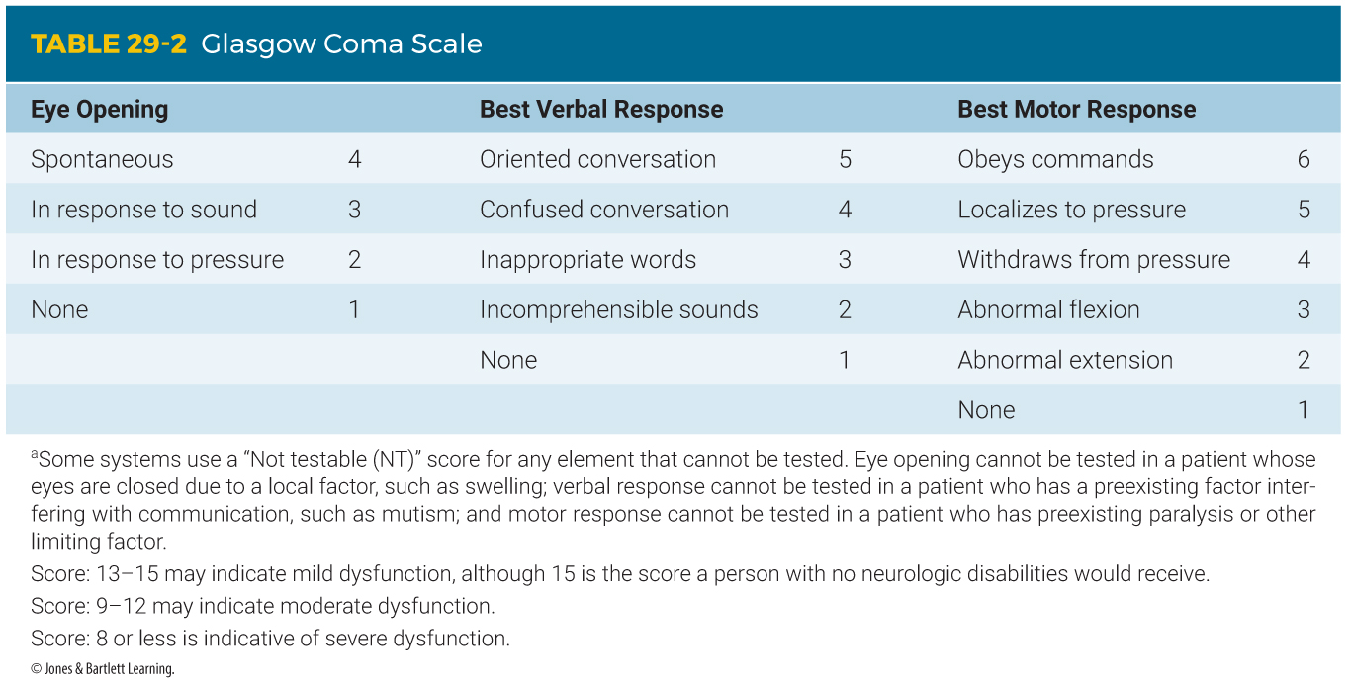
Secondary Assessment (6 of 7)
Notes:
The table on this slide shows the categories of the Glasgow Coma Scale.

Slide 85
Secondary Assessment (7 of 7)
Spine examination
  Inspect for DCAP-BTLS, and check the extremities for circulation, motor, or sensory problems.
  If there is impairment, note the level.
  Pain or tenderness when you palpate is a warning sign.
  Other signs and symptoms: deformity, numbness, weakness, or tingling in the extremities; and soft-tissue injuries
Notes:
Lecture Outline
7. Spine examination
a. Inspect for DCAP-BTLS, and check the extremities for circulation, motor, or sensory problems.
b. If there is impairment, note the level.
c. Pain or tenderness when you palpate is a warning sign that a spinal injury may exist.
d. Other signs and symptoms include an obvious deformity, numbness, weakness, or tingling in the extremities, and soft-tissue injuries in the spinal region.
e. Obvious injury to the head and neck may indicate injury to the cervical spine.

Slide 86
Reassessment (1 of 4)
Repeat the primary assessment.
Reassess vital signs and the chief complaint.
Recheck patient interventions.
  Reassess at least every 5 minutes.
Notes:
Lecture Outline
F. Reassessment
1. Repeat the primary assessment.
2. Reassess vital signs and the chief complaint.
3. Recheck patient interventions.
a. The patient’s condition should be reassessed at least every 5 minutes.

Slide 87
Reassessment (2 of 4)
Interventions
  Compare baseline vital signs with repeated vital signs.
  Rapid deterioration of neurologic signs is a sign of an expanding bleed in the brain or rapidly progressing brain swelling.
Notes:
Lecture Outline
4. Interventions
a. Compare baseline vital signs with repeated vital signs.
b. Rapid deterioration of neurologic signs following a head injury is a sign of an expanding intracranial hematoma or rapidly progressing brain swelling.

Slide 88
Reassessment (3 of 4)
Interventions (cont’d)
  If CSF is present, cover the wound with sterile gauze, but do not bandage tightly.
  Administer high-flow oxygen and apply a cervical collar.
Notes:
Lecture Outline
c. If CSF is present, cover the wound with sterile gauze to prevent further contamination, but do not bandage it tightly.
d. Your protocol should include the administration of high-flow oxygen and the application of a cervical collar, if indicated, as part of spinal immobilization.
e. Reassessment should take place as the patient is transported to an appropriate trauma facility.

Slide 89
Reassessment (4 of 4)
Communication and documentation
  Your documentation should include:
    The history you obtained at the scene
    Your findings during your assessment
    Treatments you provided
    How the patient responded to them
  Document vital signs for unstable patients every 5 minutes; every 15 for stable patients.
Notes:
Lecture Outline
5. Communication and documentation
a. Provide complete and detailed information to the destination facility.
b. Hospitals may better prepare for seriously injured patients with more advanced warning and a description of the most serious problems found during your assessment.
c. More seriously injured patients should have documented vital signs every 5 minutes.
d. More stable patients should have documented vital signs every 15 minutes.
e. You may be requested to testify as a witness.

Slide 90
Emergency Medical Care of Head Injuries (1 of 7)
Three general principles:
  Establish an adequate airway.
  Control bleeding and provide adequate circulation to maintain cerebral perfusion.
  Assess the patient’s baseline level of consciousness, and continuously monitor.
Notes:
Lecture Outline
VI. Emergency Medical Care of Head Injuries
A. Three general principles are designed to protect and maintain the critical functions of the CNS:
1. Establish an adequate airway.
2. Control bleeding and provide adequate circulation to maintain cerebral perfusion.
3. Assess the patient’s baseline level of consciousness, and continuously monitor it.

Slide 91
Emergency Medical Care of Head Injuries (2 of 7)
Managing the airway
  Perform the jaw-thrust maneuver.
  Once the airway is open, maintain the head and cervical spine in a neutral, in-line position until you have placed a cervical collar and have secured the patient on a backboard.
Notes:
Lecture Outline
B. Managing the airway
1. The most important step is establishing and maintaining an adequate airway.
a. Once the airway is open, maintain the head and cervical spine in a neutral, in-line position until you have placed a cervical collar and have secured the patient on a backboard.

Slide 92
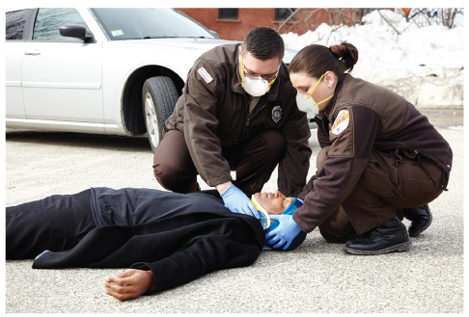
Emergency Medical Care of Head Injuries (3 of 7)
FIGURE 29-20 Apply a cervical collar as you finish the primary assessment.
© Jones & Bartlett Learning. Photo by Darren Stahlman.
Notes:
This figure shows how to stabilize maintain the head and cervical spine in a neutral in-line position and apply a cervical collar.

Slide 93
Emergency Medical Care of Head Injuries (4 of 7)
Managing the airway (cont’d)
  Remove any foreign bodies, secretions, or vomitus.
  Check ventilation.
  Give supplemental oxygen to any patient with suspected head injury.
Notes:
Lecture Outline
b. Remove any foreign bodies, secretions, or vomitus from the airway.
2. Once you have cleared the airway, check ventilation.
3. Give supplemental oxygen to any patient with suspected head injury, particularly anyone who is having trouble breathing.
4. Use a bag-mask device to assist ventilations if the patient is breathing to slow or shallow.
5. Placement of an airway device may be necessary to maintain airway patency.
6. Consider calling for ALS if the patient’s airway is compromised.

Slide 94
Emergency Medical Care of Head Injuries (5 of 7)
Circulation
  Begin CPR if the patient is in cardiac arrest.
  Active blood loss aggravates hypoxia.
  You can almost always control bleeding from a scalp laceration by applying direct pressure over the wound.
Notes:
Lecture Outline
C. Circulation
1. You must begin CPR if the patient is in cardiac arrest.
2. Active blood loss aggravates hypoxia.
a. Bleeding inside the skull may cause the ICP to rise to life-threatening levels.
3. You can almost always control bleeding from a scalp laceration by applying direct pressure over the wound.
a. If you suspect a skull fracture, do not apply excessive pressure to the open wound.
b. If the dressing becomes soaked, do not remove it, place a second dressing over the first.

Slide 95
Emergency Medical Care of Head Injuries (6 of 7)
Shock is usually the result of hypovolemia.
  Indicates that the situation is critical
  Transport immediately to a trauma center.
Notes:
Lecture Outline
5. Shock
a. Usually the result of hypovolemia caused by bleeding from other injuries
b. Transport immediately to a trauma center.

Slide 96
Emergency Medical Care of Head Injuries (7 of 7)
Cushing triad
  Increased blood pressure (hypertension)
  Decreased heart rate (bradycardia)
  Irregular respirations (Cheyne-Stokes respirations or Biot respirations)
  Manage shock, administer oxygen, and ventilate as necessary, avoiding hyperventilation.
Notes:
Lecture Outline
5. Cushing triad
a. Increased blood pressure (hypertension), decreased heart rate (bradycardia), and irregular respirations (Cheyne-Stokes or Biot)
b. If this process is allowed to continue, it is a fatal injury.
c. Manage shock, administer oxygen, and ventilate as necessary, avoiding hyperventilation.

Slide 97
Emergency Medical Care of Spinal Injuries (1 of 6)
Follow standard precautions.
Maintain the patient’s airway while keeping the spine in the proper position.
Assess respirations and give supplemental oxygen.
Notes:
Lecture Outline
VII. Emergency Medical Care of Spinal Injuries
A. Remember to follow standard precautions.
B. Maintain the patient’s airway while keeping the spine in the proper position, assess respirations, and give supplemental oxygen.

Slide 98
Emergency Medical Care of Spinal Injuries (2 of 6)
Managing the airway
  Perform the jaw-thrust maneuver.
  Consider inserting an oropharyngeal airway.
  Have a suctioning unit available.
  Provide supplemental oxygen.
Notes:
Lecture Outline
C. Managing the airway
1. Perform the jaw-thrust maneuver to open the airway.
2. Consider inserting an oropharyngeal airway.
3. Have a suctioning unit available.
4. Provide supplemental oxygen.

Slide 99
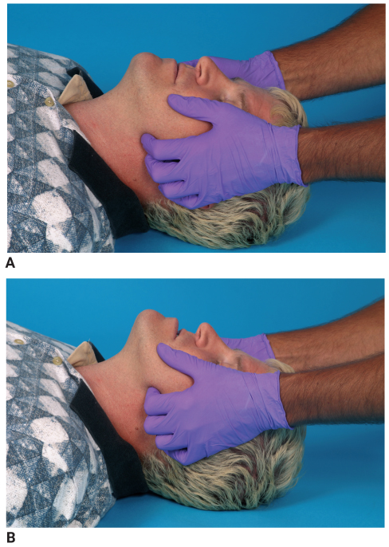
Emergency Medical Care of Spinal Injuries (3 of 6)
FIGURE 29-22 Jaw-thrust maneuver. A. Stabilize the neck in a neutral, in-line position. B. Push the angle of the lower jaw upward.
A, B: © Jones & Bartlett Learning. Courtesy of MIEMSS.
Notes:
This figure shows how to perform the jaw-thrust maneuver.

Slide 100
Emergency Medical Care of Spinal Injuries (4 of 6)
Spinal motion restriction of the cervical spine
  Immobilize the head and trunk so that bone fragments do not cause further damage.
  Never force the head into a neutral, in-line position.
  Immobilize the patient in his or her current position.
Notes:
Lecture Outline
D. Spinal motion restriction of the cervical spine
1. Immobilize the head and trunk so that bone fragments do not cause further damage.
2. Even small movements can cause significant injury to the spinal cord.
3. Follow the steps in Skill Drill 29-1.
4. Never force the head into a neutral, in-line position; do not move the head any farther if the patient reports any of the following symptoms:
a. Muscle spasms in the neck
b. Substantial increased pain
c. Numbness, tingling, or weakness in the arms or legs
d. Compromised airway or ventilations
5. In these situations, stabilize the patient in his or her current position.

Slide 101
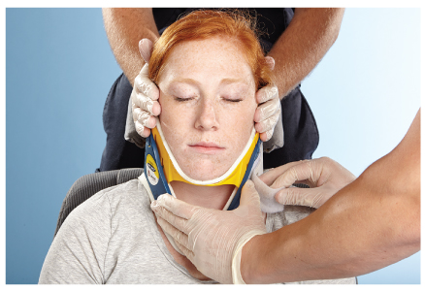
Emergency Medical Care of Spinal Injuries (5 of 6)
Cervical collars
  Provide preliminary, partial support
  Should be applied to every patient who has a possible spinal injury
  To be effective, a rigid cervical collar must be the correct size.
FIGURE 29-23 Proper fit is essential in applying a cervical
collar. The collar should rest on the shoulder girdle and
provide firm support under both sides of the mandible
without obstructing the airway or any ventilation efforts.
© Jones & Bartlett Learning.
Notes:
Lecture Outline
E. Cervical collars
1. Provide preliminary, partial support
2. Should be applied to every patient who has a possible spinal injury based on the MOI, history, or signs and symptoms.
3. To be effective, a rigid cervical collar must be the correct size for the patient.

Slide 102
Emergency Medical Care of Spinal Injuries (6 of 6)
Cervical collars (cont’d)
  Once the patient’s head and neck have been manually stabilized, assess the pulse, motor functions, and sensation in all extremities. Then assess the cervical spine area and neck.
  Maintain manual support until the patient has been fully secured to the backboard or vacuum mattress.
Notes:
Lecture Outline
4. Follow the steps in Skill Drill 29-2.
5. Once the patient’s head and neck have been manually stabilized, assess the pulse, motor functions, and sensation in all extremities. Then assess the cervical spine area and neck.
6. Maintain manual support until the patient has been fully secured to the backboard or vacuum mattress.

Slide 103
Preparation for Transport (1 of 7)
Supine patients
  Secure to a long backboard or vacuum mattress.
  Another procedure to move a patient from the ground to a backboard is the four-person log roll.
  You may also slide the patient onto a backboard or vacuum mattress.
Notes:
Lecture Outline
VIII. Preparation for Transport
A. Supine patients
1. Secure the patient to a long backboard or vacuum mattress.
2. Another procedure to move a patient from the ground to a backboard is the four-person log roll.
3. You may also slide the patient onto a backboard or vacuum mattress.
4. To secure a patient to a backboard, follow the steps in Skill Drill 29-3.

Slide 104
Preparation for Transport (2 of 7)
Vacuum mattress
  An alternative to the long backboard is a vacuum mattress.
  Molds to the specific contours of patient’s body
  Excellent for the elderly or a patient with abnormal curvature of the spine
  Can be used on a supine, sitting, or standing patient
Notes:
Lecture Outline
B. Vacuum mattress
1. An alternative to the long backboard is a vacuum mattress.
a. Molds to the specific contours of the patient’s body, reducing pressure-point tenderness and therefore providing better comfort
b. Also provides thermal insulation
c. Excellent for the elderly or a patient with abnormal curvature of the spine
d. Drawback to the device is its thickness, requiring careful patient movement to maintain spinal stabilization
e. Cannot be used for patients who weigh more than 350 lb
f. Can be used on a supine, sitting, or standing patient
g. Patient can be moved onto the vacuum mattress with a scoop stretcher or a log roll.
2. Follow the steps in Skill Drill 29-4.

Slide 105
Preparation for Transport (3 of 7)
Sitting patients
  Use a short backboard to restrict movement of the cervical and thoracic spine.
  Then secure the short board to the long board.
  Exceptions include situations in which:
    You or the patient is in danger.
    You need immediate access to other patients.
    The patient’s injuries justify urgent removal.
Notes:
Lecture Outline
C. Sitting patients
1. Use a short backboard or other short spinal extrication device to restrict movement of the cervical and thoracic spine.
2. Then secure the short backboard to the long backboard.
3. Exceptions to this rule include situations in which:
a. You or the patient is in danger
b. You need to gain immediate access to other patients
c. The patient’s injuries justify urgent removal
4. In all other cases, follow the steps in Skill Drill 29-5.

Slide 106
Preparation for Transport (4 of 7)
Standing patients
  Transfer patient to a position in which spinal motion restriction can be maintained.
  Clinical indications for spinal motion restriction:
    Spinal tenderness or pain
    Altered level of consciousness
    Neurologic deficits
    Obvious spinal deformity
    High-energy trauma in an intoxicated patient or one with a distracting injury
Notes:
Lecture Outline
D. Standing patients
1. A patient who is already standing and walking should be able to sit down gently and be transferred to a position in which spinal motion restriction can be maintained.
2. If the MOI and clinical indications suggest spinal injury or the patient’s inability to protect his or her spine, establish spinal motion restriction. Clinical indications may include:
a. Spinal tenderness or pain
b. An altered level of consciousness
c. Neurologic deficits
d. Obvious anatomic deformity of the spine
e. High-energy trauma in a patient intoxicated from drugs, alcohol, or a distracting injury

Slide 107
Preparation for Transport (5 of 7)
Spinal immobilization devices
  Assume the presence of spinal injury in all patients who have sustained head injuries.
  Use manual in-line stabilization or a cervical collar and long backboard.
Notes:
Lecture Outline
E. Spinal immobilization devices
1. During assessment, pain in the spine may be missed because of shock or because the patient’s attention is directed to more painful injuries.
2. Because any manipulation of the unstable cervical spine may cause permanent damage to the spinal cord, you must assume the presence of spinal injury in all patients who have sustained head injuries.
3. Use manual in-line stabilization or a cervical collar and long backboard.

Slide 108
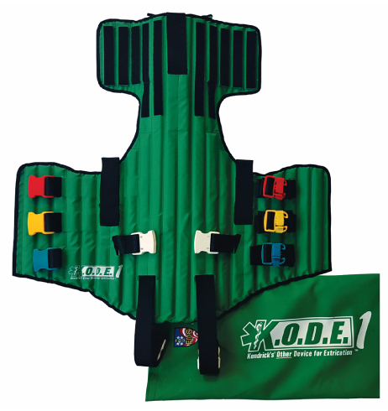
Preparation for Transport (6 of 7)
Short backboards
  Vest-type device and rigid short board
  Designed to immobilize and restrict movement of the head, neck, and torso
  Used to immobilize noncritical patients found in a sitting position
FIGURE 29-25 A common short-board spinal precaution device is a vest-type device.
© Kendrick EMS.
Notes:
Lecture Outline
4. Short backboards
a. The most common short backboards are the vest-type device and the rigid short board.
b. Designed to immobilize and restrict movement of the head, neck, and torso.
c. Used to immobilize noncritical patients who are found in a sitting position and have possible spinal injuries

Slide 109
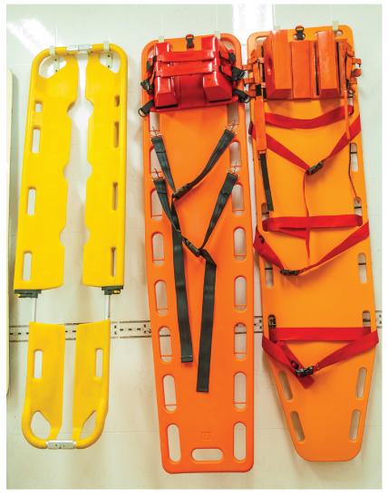
Preparation for Transport (7 of 7)
Long backboards
  Provide full body spinal immobilization and motion restriction to the head, neck, torso, pelvis, and extremities
  Used to immobilize patients found in any position
FIGURE 29-26 Long backboards provide full-body spinal motion restriction, including the head, neck, torso, pelvis, and extremities.
© meenon/iStock/Getty Images Plus/Getty Images.
Notes:
Lecture Outline
5. Long backboards
a. Provide full body spinal immobilization and motion restriction to the head, neck, torso, pelvis, and extremities.
b. Used to immobilize patients who are found in any position, sometimes in conjunction with short backboards.

Slide 110
Helmet Removal (1 of 6)
A helmet that fits well prevents the patient’s head from moving and should be left on, provided:
  There are no impending airway or breathing problems.
  It does not interfere with assessment and treatment of airway or ventilation problems.
  You can properly immobilize the spine.
Notes:
Lecture Outline
IX. Helmet Removal
A. A helmet that fits well prevents the patient’s head from moving and should be left on, provided:
1. There are no impending airway or breathing problems.
2. It does not interfere with assessment and treatment of airway or ventilation problems.
3. You can properly immobilize the spine.

Slide 111
Helmet Removal (2 of 6)
Remove a helmet if:
  It is a full-face helmet.
  It makes assessing or managing airway problems difficult.
  It prevents you from properly immobilizing the spine.
  It allows excessive head movement.
  The patient is in cardiac arrest.
Notes:
Lecture Outline
B. Remove a helmet if:
1. It is a full-face helmet.
2. It makes assessing or managing airway problems difficult, and removal of a face guard to improve airway access is not possible.
3. It prevents you from properly immobilizing the spine.
4. It allows excessive head movement.
5. The patient is in cardiac arrest.

Slide 112
Helmet Removal (3 of 6)
Preferred method
  Removing a helmet should always be at least a two-person job.
  You should first consult with medical control about your decision to remove a helmet.
Notes:
Lecture Outline
D. Preferred method
1. Removing a helmet should always be at least a two-person job.
2. Technique for helmet removal depends on the actual type of helmet worn by the patient.
3. You and your partner should not move at the same time.
4. You should first consult with medical control about your decision to remove a helmet.
5. Follow the steps in Skill Drill 29-6.

Slide 113
Helmet Removal (4 of 6)
Alternate method
  The advantage is that it allows the helmet to be removed with the application of less force, therefore reducing the likelihood of motion occurring in the neck.
  The disadvantage is that it is slightly more time consuming.
Notes:
Lecture Outline
E. Alternate method
1. The advantage of this method is that it allows the helmet to be removed with the application of less force, thereby reducing the likelihood of motion occurring in the neck.
2. The disadvantage is that it is slightly more time consuming.

Slide 114
Helmet Removal (5 of 6)
Alternate method (cont’d)
  Remove the chin strap.
  Remove the face mask.
  Pop the jaw pads out of place.
  Place your fingers inside the helmet.
  Hold the jaw with one hand and the occiput with the other.
  Insert padding behind the occiput.
Notes:
Lecture Outline
Steps to the alternate method:
a. Remove the chin strap.
b. Remove the face mask (cut or unscrew the plastic clips).
c. Pop the jaw pads out of place with a tongue depressor.
d. Place your fingers inside the helmet during removal of the helmet.
e. The person at the side of the patient controls the head by holding the jaw with one hand and the occiput with the other.
f. Insert padding behind the occiput to prevent neck extension.

Slide 115
Helmet Removal (6 of 6)
Alternate method (cont’d)
  The person at the side of the patient’s chest is responsible for making sure that the head and neck do not move during removal of the helmet.
  Remember that children may require additional padding to maintain the in-line neutral position.
Notes:
Lecture Outline
g. The person at the side of the patient’s chest is responsible for making sure that the head and neck do not move during removal of the helmet.
h. Remember that small children may require additional padding to maintain the in-line neutral position.

Slide 116
Review
The brain, a part of the central nervous system (CNS), is divided into the:
  cerebrum, cerebellum, and brainstem.
  cerebrum, brainstem, and spinal cord.
  cerebellum, cerebrum, and spinal cord.
  spinal cord, cerebrum, and cerebral cortex.

Slide 117
Review
Answer: A
Rationale: The brain and spinal cord comprise the central nervous system (CNS). The brain is divided into three major regions: the cerebrum (the largest portion), the cerebellum, and the brainstem. Each region of the brain carries out specific functions.

Slide 118
Review
The brain, a part of the central nervous system (CNS), is divided into the:
  cerebrum, cerebellum, and brainstem.
  Rationale: Correct answer
  cerebrum, brainstem, and spinal cord.
  Rationale: The spinal cord is not part of the brain.
  cerebellum, cerebrum, and spinal cord.
  Rationale: The spinal cord is not part of the brain.
  spinal cord, cerebrum, and cerebral cortex.
  Rationale: The spinal cord is not part of the brain.

Slide 119
Review
As you are assessing a 24-year-old man with a large laceration to the top of his head, you should recall that:
  the scalp, unlike other parts of the body, has relatively fewer blood vessels.
  blood loss from a scalp laceration may contribute to hypovolemic shock in adults.
  any avulsed portions of the scalp should be carefully cut away to facilitate bandaging.
  most scalp injuries are superficial and are rarely associated with more serious injuries.

Slide 120
Review
Answer: B
Rationale: Although the scalp is highly vascular and tends to bleed heavily when injured, scalp injuries are rarely the sole cause of hypovolemic shock in adults. However, they can contribute to hypovolemia caused by injuries elsewhere in the body. Scalp lacerations, whether deep or superficial, should prompt you to look for more serious underlying injuries, such as a skull fracture. If the injury involves an avulsion, the avulsed flap of skin should be carefully replaced to its original position, not cut away.

Slide 121
Review
As you are assessing a 24-year-old man with a large laceration to the top of his head, you should recall that:
  the scalp, unlike other parts of the body, has relatively fewer blood vessels.
  Rationale: The scalp is highly vascular.
  blood loss from a scalp laceration may contribute to hypovolemic shock in adults.
  Rationale: Correct answer
  any avulsed portions of the scalp should be carefully cut away to facilitate bandaging.
  Rationale: The avulsed flap should be carefully replaced to its original position.
  most scalp injuries are superficial and are rarely associated with more serious injuries.
  Rationale: Deep or superficial scalp lacerations should prompt EMS providers to assess for more serious underlying injuries.

Slide 122
Review
A patient who experiences an immediate loss of consciousness followed by a lucid interval has a(n):
  epidural hematoma.
  subdural hematoma.
  concussion.
  contusion.

Slide 123
Review
Answer: A
Rationale: Epidural hematomas are caused by injury to an artery—usually the middle meningeal artery—that lies in between the skull and brain. Patients with an epidural hematoma typically experience an immediate loss of consciousness followed by a brief period of consciousness (lucid interval) as intracranial pressure increases. Subdural hematomas are the result of injury to a vein; therefore, they tend to bleed slowly and usually cause a progressive decline in level of consciousness. Concussions and contusions may cause a loss of consciousness, but it is typically brief.

Slide 124
Review
A patient who experiences an immediate loss of consciousness followed by a lucid interval has a(n):
  epidural hematoma.
  Rationale: Correct answer
  subdural hematoma.
  Rationale: Subdural hematomas tend to bleed slowly and usually cause a progressive decline in the level of consciousness.
  concussion.
  Rationale: Concussions may cause a loss of consciousness, but it is typically brief.
  contusion.
  Rationale: Contusions may cause a loss of consciousness, but it is typically brief.

Slide 125
Review
A 44-year-old man was struck in the back of the head and was reportedly unconscious for approximately 30 seconds. He complains of a severe headache and “seeing stars,” and states that he regained his memory shortly before your arrival. His presentation is MOST consistent with a(n):
  contusion.
  concussion.
  subdural hematoma.
  intracerebral hemorrhage.

Slide 126
Review
Answer: B
Rationale: A concussion occurs when the brain is jarred around inside the skull. It may result in a brief loss of consciousness and occasionally, amnesia. Seeing stars is a common finding following trauma to the back of the head (occiput), as this region is primarily responsible for vision. A concussion—the least severe of all closed head injuries—typically does not result in physical damage to the brain. Compared to a concussion, a contusion, subdural hematoma, and intracerebral hemorrhage are usually associated with a more prolonged loss of consciousness.

Slide 127
Review
A 44-year-old man was struck in the back of the head and was reportedly unconscious for approximately 30 seconds. He complains of a severe headache and “seeing stars,” and states that he regained his memory shortly before your arrival. His presentation is MOST consistent with a(n):
  contusion.
  Rationale: This is when brain tissue is damaged, and the patient presents with prolonged confusion and loss of consciousness.
  concussion.
  Rationale: Correct answer
  subdural hematoma.
  Rationale: This is an accumulation of blood beneath the dura mater.
  intracerebral hemorrhage.
  Rationale: This is bleeding within the brain itself.

Slide 128
Review
A young male was involved in a motor vehicle accident and experienced a closed head injury. He has no memory of the events leading up to the accident but remembers that he was going to a birthday party. What is the correct term to use when documenting his memory loss?
  Concussion
  Cerebral contusion
  Retrograde amnesia
  Anterograde amnesia

Slide 129
Review
Answer: C
Rationale: The term amnesia means loss of memory; it is common in patients who have experienced a cerebral concussion. Amnesia of events leading up to an injury is called retrograde amnesia. Anterograde amnesia—also called posttraumatic amnesia—is the inability to remember events that occurred—or will occur—after the injury.

Slide 130
Review
A young male was involved in a motor-vehicle accident and experienced a closed head injury. He has no memory of the events leading up to the accident but remembers that he was going to a birthday party. What is the correct term to use when documenting his memory loss?
  Concussion
  Rationale: This occurs when the brain is jarred inside the skull.
  Cerebral contusion
  Rationale: This is when tissue is bruised and damaged in a local area. It may result in prolonged confusion.
  Retrograde amnesia
  Rationale: Correct answer
  Anterograde amnesia
  Rationale: This is the loss of memory relating to events that occurred after the injury.

Slide 131
Review
A distraction injury to the cervical spine would MOST likely occur following:
  a diving accident.
  blunt neck trauma.
  hyperextension of the neck.
  hanging-type mechanisms.

Slide 132
Review
Answer: D
Rationale: Excessive traction on the neck, such as what occurs during hanging-type mechanisms, can cause a distraction injury of the cervical spine. Distraction injuries can cause separation of the vertebrae and stretching or tearing of the spinal cord.

Slide 133
Review
A distraction injury to the cervical spine would MOST likely occur following:
  a diving accident.
  Rationale: This would possibly cause a compression injury.
  blunt neck trauma.
  Rationale: This can result in a fracture or neurologic deficit.
  hyperextension of the neck.
  Rationale: This can result in a fracture or neurologic deficit.
  hanging-type mechanisms.
  Rationale: Correct answer

Slide 134
Review
During immobilization of a patient with a possible spinal injury, manual stabilization of the head must be maintained until:
  an appropriate-size extrication collar has been placed.
  the patient is fully immobilized on a long backboard.
  a range of motion test of the neck has been completed.
  pulse, motor, and sensory functions are found to be intact.

Slide 135
Review
Answer: B
Rationale: Manual stabilization of the patient’s head must be maintained until he or she is fully secured to the long backboard. This includes the application of an extrication collar, straps, and lateral immobilization (head blocks). Pulse, motor, and sensory functions must be checked before and after the immobilization process. Do not assess range of motion in a patient with a possible spinal injury; this involves moving the patient’s neck and may cause further injury.

Slide 136
Review
During immobilization of a patient with a possible spinal injury, manual stabilization of the head must be maintained until:
  an appropriate-size extrication collar has been placed.
  Rationale: This is only one small part of the total immobilization process.
  the patient is fully immobilized on a long backboard.
  Rationale: Correct answer
  a range of motion test of the neck has been completed.
  Rationale: Do not assess the range of motion in a patient with a possible spinal injury.
  pulse, motor, and sensory functions are found to be intact.
  Rationale: This is done before and after complete immobilization.

Slide 137
Review
Your patient is a 21-year-old male who has massive face and head trauma after being assaulted. He is lying supine, is semiconscious, and has blood in his mouth. You should:
  insert a nasal airway, assess his respirations, and give 100% oxygen.
  suction his airway and apply high-flow oxygen via a nonrebreathing mask.
  manually stabilize his head, log roll him onto his side, and suction his mouth.
  apply a cervical collar, suction his airway, and begin assisting his ventilations.

Slide 138
Review
Answer: C
Rationale: Blood or other secretions in the mouth place the airway in immediate jeopardy and must be removed before they are aspirated. At the same time, you must protect the patient’s spine due the mechanism of injury. Therefore, you should manually stabilize the patient’s head, log roll him onto his side (allows drainage of blood from his mouth), and suction his mouth for up to 15 seconds. After ensuring that his airway is clear, assess his breathing and give high-flow oxygen or assist his ventilations. Nasal airways should not be used in patients with severe facial or head trauma.

Slide 139
Review
Your patient is a 21-year-old male who has massive face and head trauma after being assaulted. He is lying supine, is semiconscious, and has blood in his mouth. You should:
  insert a nasal airway, assess his respirations, and give 100% oxygen.
  Rationale: Nasal airways should not be used in patients with severe facial or head trauma or with suspected fractures.
  suction his airway and apply high-flow oxygen via a nonrebreathing mask.
  Rationale: This must be done after manual stabilization of the spine and rolling the patient to his side.
  manually stabilize his head, log roll him onto his side, and suction his mouth.
  Rationale: Correct answer
  apply a cervical collar, suction his airway, and begin assisting his ventilations.
  Rationale: The cervical collar should be applied but manual stabilization must take place first. There are no indications here that the patient’s rate of respirations are inadequate and require assisted ventilations.

Slide 140
Review
A man is found slumped over the steering wheel, unconscious and making snoring sounds, after an automobile accident. His head is turned to the side and his neck is flexed. You should:
  gently rotate his head to correct the deformity.
  carefully hyperextend his neck to open his airway.
  apply an extrication collar with his head in the position found.
  manually stabilize his head and move it to a neutral, in-line position.

Slide 141
Review
Answer: D
Rationale: The patient’s snoring sounds indicate an airway problem, which must be corrected or he may die. Manually stabilize his head; carefully move it to a neutral, in-line position; and reassess his breathing. Do not rotate or hyperextend the neck of a patient with a possible spinal injury; the results could be disastrous.

Slide 142
Review
A man is found slumped over the steering wheel, unconscious and making snoring sounds, after an automobile accident. His head is turned to the side and his neck is flexed. You should:
  gently rotate his head to correct the deformity.
  Rationale: Do not rotate the neck of a patient with a possible spinal injury.
  carefully hyperextend his neck to open his airway.
  Rationale: Do not hyperextend the neck of a patient with a possible spinal injury.
  apply an extrication collar with his head in the position found.
  Rationale: The head must be placed in a neutral position to open the airway.
  manually stabilize his head and move it to a neutral, in-line position.
  Rationale: Correct answer

Slide 143
Review
You should NOT remove an injured football player’s helmet if:
  a cervical spine injury is suspected, even if the helmet fits loosely.
  the patient has a patent airway, even if he has breathing difficulty.
  he has broken teeth, but only if the helmet does not fit snugly in place.
  the face guard can easily be removed and there is no airway compromise.

Slide 144
Review
Answer: D
Rationale: In general, you should leave a helmet on if it fits snugly and does not allow movement of the head within the helmet, the patient’s airway is patent, no airway problems are anticipated, and the patient is breathing without difficulty. If you can easily remove the face guard (often the case with football helmets) and there are no airway problems, do so but leave the helmet on. If the helmet is loose, the airway is in anyway compromised, or the patient has difficulty breathing or is in cardiac arrest, the helmet must be removed.

Slide 145
Review
You should NOT remove an injured football player’s helmet if:
  a cervical spine injury is suspected, even if the helmet fits loosely.
  Rationale: If the helmet allows for movement of the head, it should be removed.
  the patient has a patent airway, even if he has breathing difficulty.
  Rationale: The helmet must be removed if the patient is having breathing difficulty.
  he has broken teeth, but only if the helmet does not fit snugly in place.
  Rationale: Broken teeth present a potential for airway obstruction.
  the face guard can easily be removed and there is no airway compromise.
  Rationale: Correct answer

